Slide 1
Minion AI
Team 9
Notes:
Good afternoon everyone! We are team 9, here to present our Minion AI. To briefly introduce ourselves, our members are

Slide 2
Automating the Software Development Lifecycle
Notes:
As a summary of our project, our goal was to automate the software development lifecycle.
What if, when we have a design meeting to discuss the implementation of a new feature, our job was done? The implementation itself would be entirely taken care of for us?

Slide 3

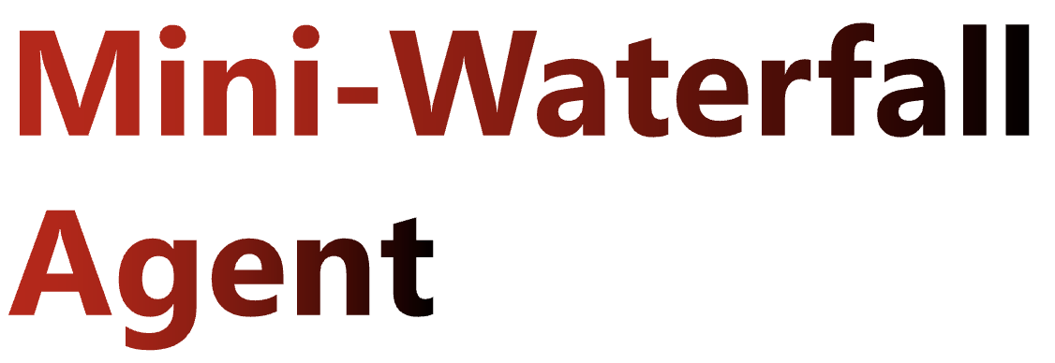
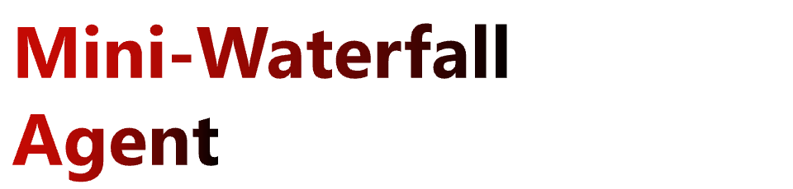
Extract and formalize requirements
Create design specifications
Set up Git environment
Implement the feature
Develop tests
Notes:
As we thought further about this concept, we landed on this idea: Creating an AI agent that follows a waterfall-like process to implement the feature. This is useful, since an AI agent of any kind is essentially a black box, and letting it output artifacts at each checkpoint like requirements and design specs would be crucial for documenting and reviewing.

Slide 4
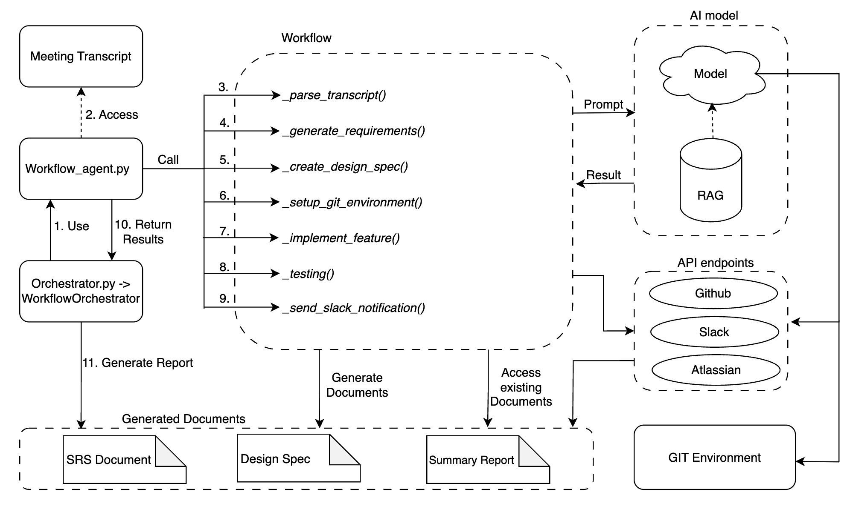

High level architecture/flow
Notes:
This was the architecture we decided on. The workflow would be carried out by the workflow agent, which would first take the meeting transcript from teams, parse it to be more digestible, and use that for the rest of the workflow. AI with RAG would be used at several points, which in turn would access the necessary resources. At the end, the artifact documents would be generated as an output as well.

Slide 5
High level architecture/flow
Notes:
This was the architecture we decided on. The workflow would be carried out by the workflow agent, which would first take the meeting transcript from teams, parse it to be more digestible, and use that for the rest of the workflow. AI with RAG would be used at several points, which in turn would access the necessary resources. At the end, the artifact documents would be generated as an output as well.

Slide 6
High level architecture/flow
Notes:
This was the architecture we decided on. The workflow would be carried out by the workflow agent, which would first take the meeting transcript from teams, parse it to be more digestible, and use that for the rest of the workflow. AI with RAG would be used at several points, which in turn would access the necessary resources. At the end, the artifact documents would be generated as an output as well.

Slide 7
High level architecture/flow
Notes:
This was the architecture we decided on. The workflow would be carried out by the workflow agent, which would first take the meeting transcript from teams, parse it to be more digestible, and use that for the rest of the workflow. AI with RAG would be used at several points, which in turn would access the necessary resources. At the end, the artifact documents would be generated as an output as well.

Slide 8
High level architecture/flow
Notes:
This was the architecture we decided on. The workflow would be carried out by the workflow agent, which would first take the meeting transcript from teams, parse it to be more digestible, and use that for the rest of the workflow. AI with RAG would be used at several points, which in turn would access the necessary resources. At the end, the artifact documents would be generated as an output as well.

Slide 9
Two-Pronged Approach
Five-man manual implementation
Divide modular components between developers
Multi-branch + PR development flow
Multiple team sync ups necessary
Difficult to test
Difficult to integrate
More control over the logic
One-man vibe-coded implementation
Everything is made in a single prompt
Continual prompt engineering development flow
A lot of up-front details necessary
Instantly testable
No need for integration, all made in one go
Less control over the logic
Notes:
To develop this agent, we employed a two-pronged approach. While we had 5 people working diligently on a manual implementation, we had one person single-handedly crafting the perfect prompt to employ Claude Code to create the entire thing by itself. There are some points listed here describing the differences between the two, but it boils down to the manual side being difficult to integrate but having more flexibility, whereas the vibe-code side was easy to implement but was harder to perfect.
Now I'll let the rest of the team go over the components.

Slide 10
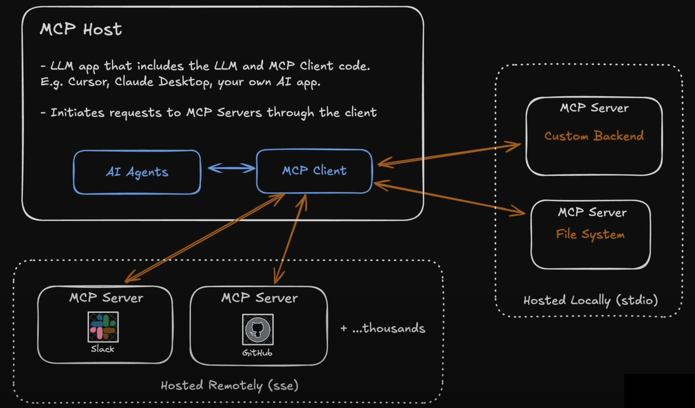
MCP Server Overview
Allows the AI model to interact with external tools
Example usage:
Upload documents
Get Confluence spaces
Create pull requests
Uses LangChain MCP Adapter
A wrapper framework
Connect multiple MCP servers and load tools
Notes:
- For our project, we decided to use MCP servers in our architecture.
- By integrating MCP, we reduce the need to learn API calls for external tooling
- and we can integrate AI models to create queries to MCP servers for their tools - To create MCP clients, we used the LangChain MCP Adapter framework,
- where MCP clients can connect to multiple MCP servers for our workflow
- By using this structure, we create consistent tool loading for our workflow and simplify our architecture

Slide 11
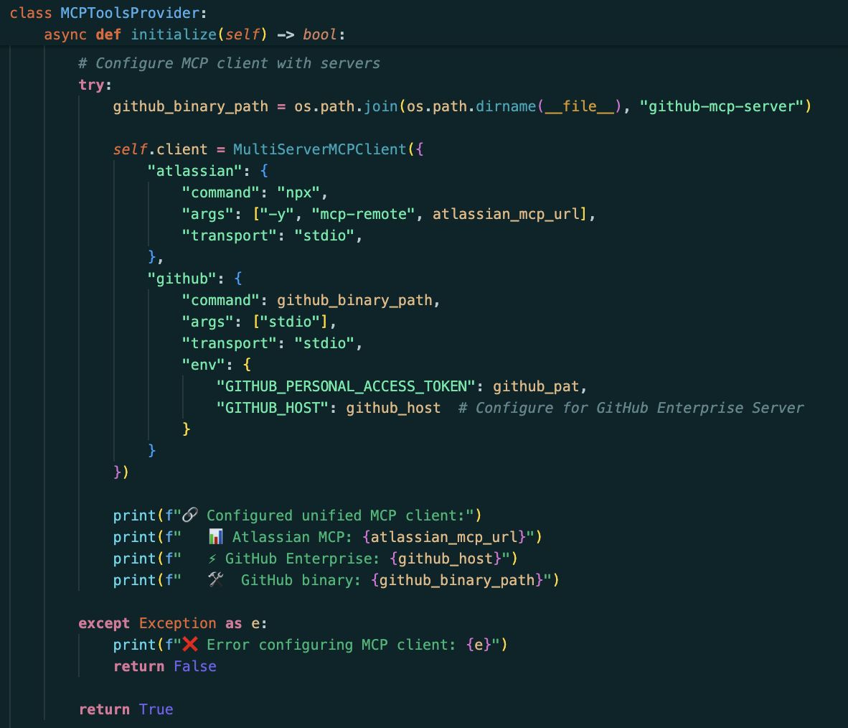
MCP Server Code
Initialized a multi-server MCP client
Contains configurations for our MCP servers
The official Atlassian MCP server
The official GitHub MCP server
Confluence MCP server setup via Node.js (local bridge)
Direct cloud integration
AI model + RAG used to create requests to the MCP servers
Notes:
- Moving on to the MCP code, we initialize a multi-server MCP client using the LangChain MCP Adapter tools
- and then provide the configurations for our MCP servers
- In our project, we use the official Atlassian and GitHub MCP servers:
- To setup the Atlassian MCP server, we used Node.js (npx) to locally run a proxy to allow interactions with the remote MCP server
- For the GitHub MCP server, we simply use an executable to interact with the remote MCP server
- Throughout the rest of the workflow, we can simply provide queries to the MCP client.
- The client then determines the appropriate tooling to use and creates requests to the client’s MCP servers

Slide 12
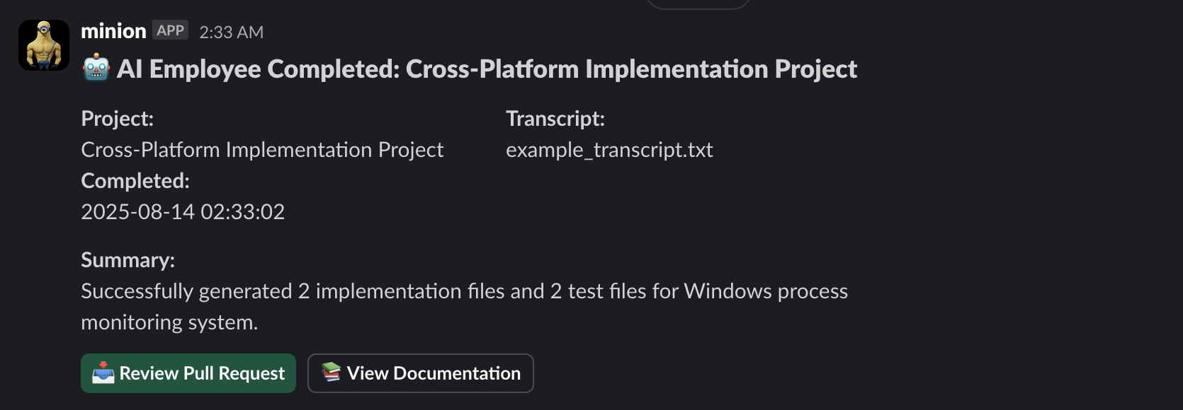
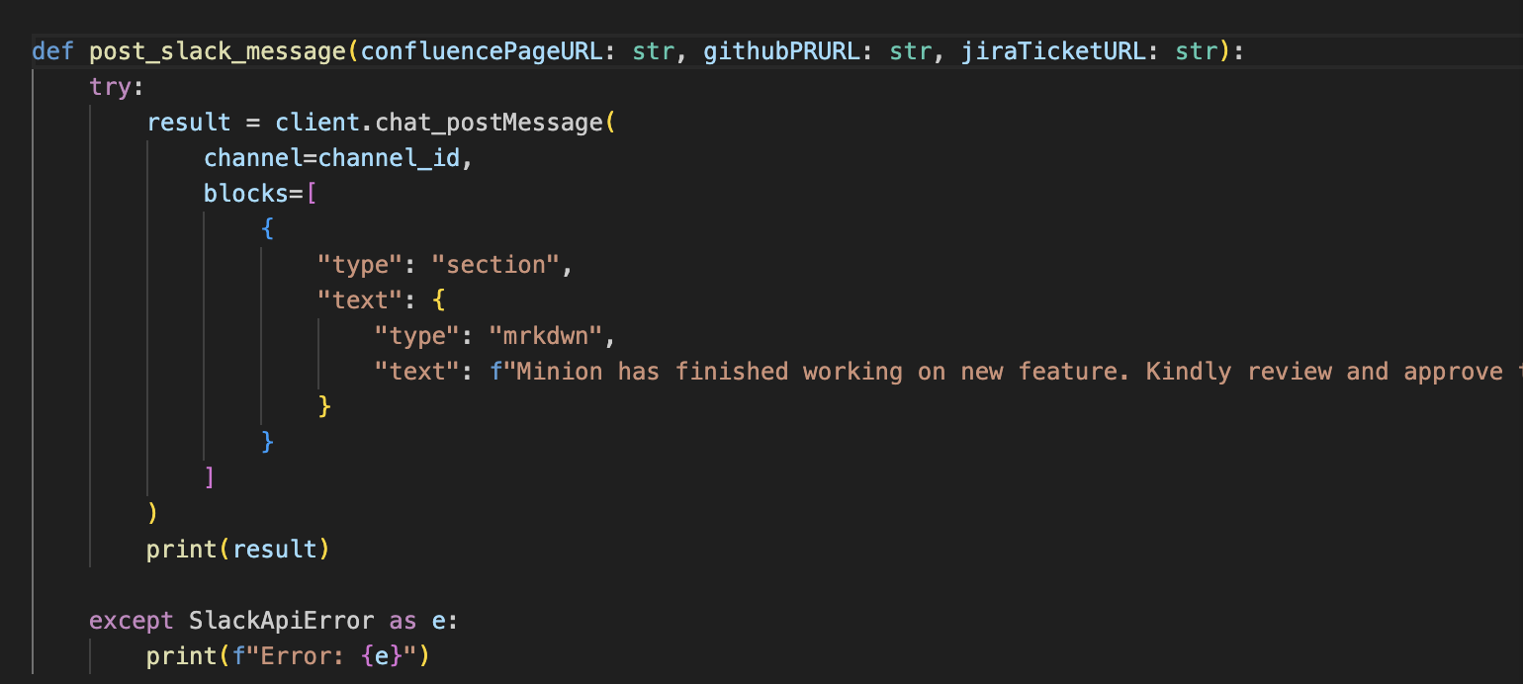
Slackbot
Sends notification to Slack
to update developers on the following:
Transcript used
Summary
Link to PR
Link to Confluence Pages
Built using the Python Slack sdk
Notes:
We also implemented a slackbot to notify developers of the workflow.
We hoped to leverage teams mcp but due to time constraints we had to use slack for this POC
As seen on the screenshot, this slackbot updates developers on the transcript used, a summary of the workflow and links to the PR and confluence pages for review.

Slide 13

RAG
Used for prerequisite knowledge AND Current run knowledge
Chroma DB (vector db)
text-embedding-3-large (embedding model)
Splitting documents to chunks for better query accuracy
Notes:
For this project, we also implemented RAG – Retreival augmented generation using chroma DB a vector database To ensure more relevant results
This database is populated with pre-requisite knowledge and current knowledge the agent may require
Also, To ensure better query accuracy, we split the document into chunks while populating the database
Using chroma db as its open source makes it easy to use and it integrates well with AI models and other frameworks
While chroma db runs locally, we did connect it to RDsec One and used one of the embedding models provided by them
Used this embedding model for higher accuracy and richer embeddings. especially good for complex text or tasks requiring nuanced understanding
RAG (Reterieval augmented generation) AI framework that combines the strengths of information retrieval with generative large language models (LLMs)

Slide 14
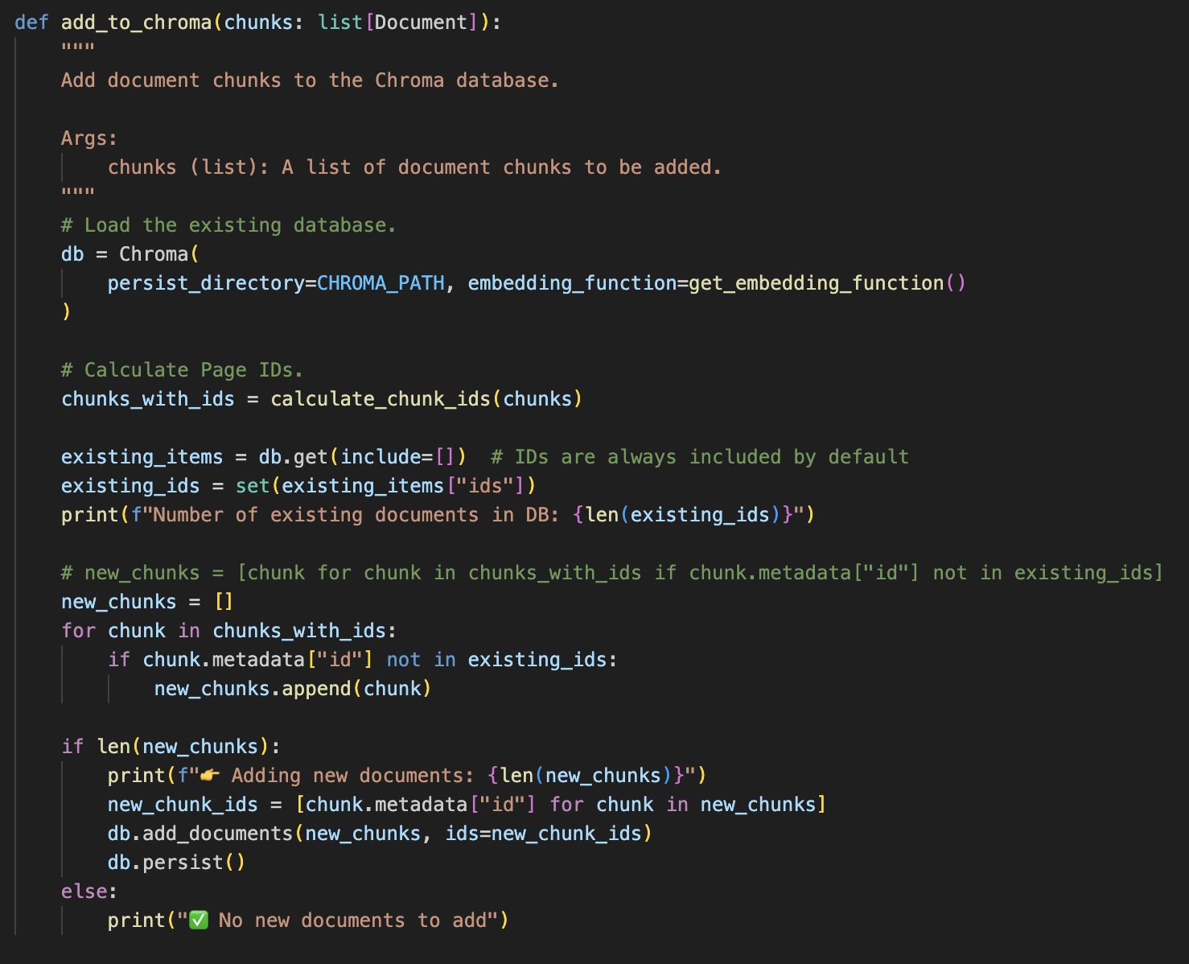
RAG
Notes:
Here is a snippet of code to show how it was implemented
Angus will now talk about our demo feature

Slide 15
Existing Code
The target application was a simple Linux stress testing application which performed file (open, write, rename, delete) and process lifecycle (fork, terminate) activities
Written in "C" for a Linux OS (Ubuntu 22)
Generated using RDSec ChatGPT with multiple prompt refinements and minor manual code changes
Main branch of the target repo @ https://dsgithub.trendmicro.com/kien-do/ai-hackathon-2025-multiplatform-code
Notes:
For our demo feature, we have a stress test made for Linux that we will want to port to Windows.
The stress test, generated by Claude Code applies heavy file operations, which involves not only writing data, but also making metadata changes, such as user and group metadata. In addition to file operations, the test spawns a large number of child processes and then terminates them.
The executable can take a variety of parameters for the various magic numbers in such a test, such as the size of the random data written to each file, the number of files, number of child processes, etc. This was written in C99, according to prompts, and included Doxygen markup. Then refinement were made through human intervention.

Slide 16
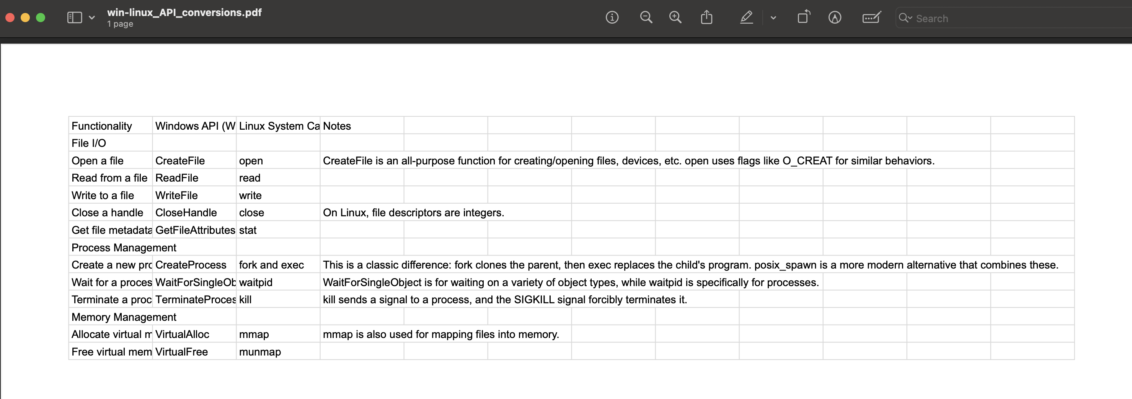
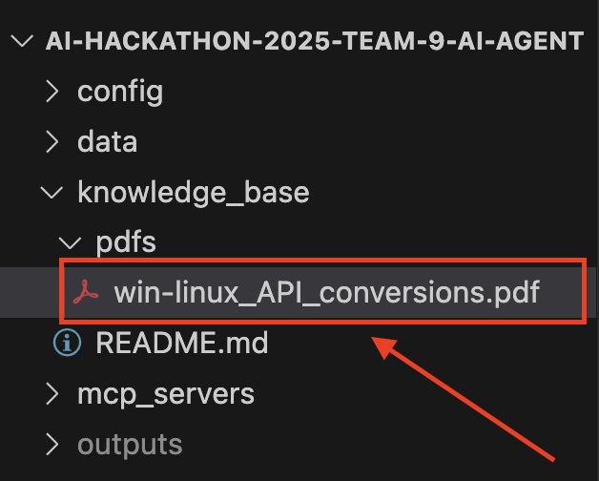
RAG Population
Notes:
For the RAG population, we created a PDF that contains the mappings of the Windows API calls to Linux System Calls. We put this PDF into the vector database to give it relevant technical knowledge of how to complete the task.
If this workflow were in production, we would put a lot more internal data sources, such as Confluence Wiki pages, so that it knows how we create Jira tickets internally, and how our development culture works.

Slide 17

Notes:
A few hours into this hackathon, we just had a myriad of problems…
When anyone came by to ask us how our project was going, we always responded with……. SIGHHHHHHHHHHH

Slide 18

Alternate Development Path
Notes:
So, I discussed with the team and suggested a high risk, high reward path.
I would try to build the entire project, with vibe coding…

Slide 19
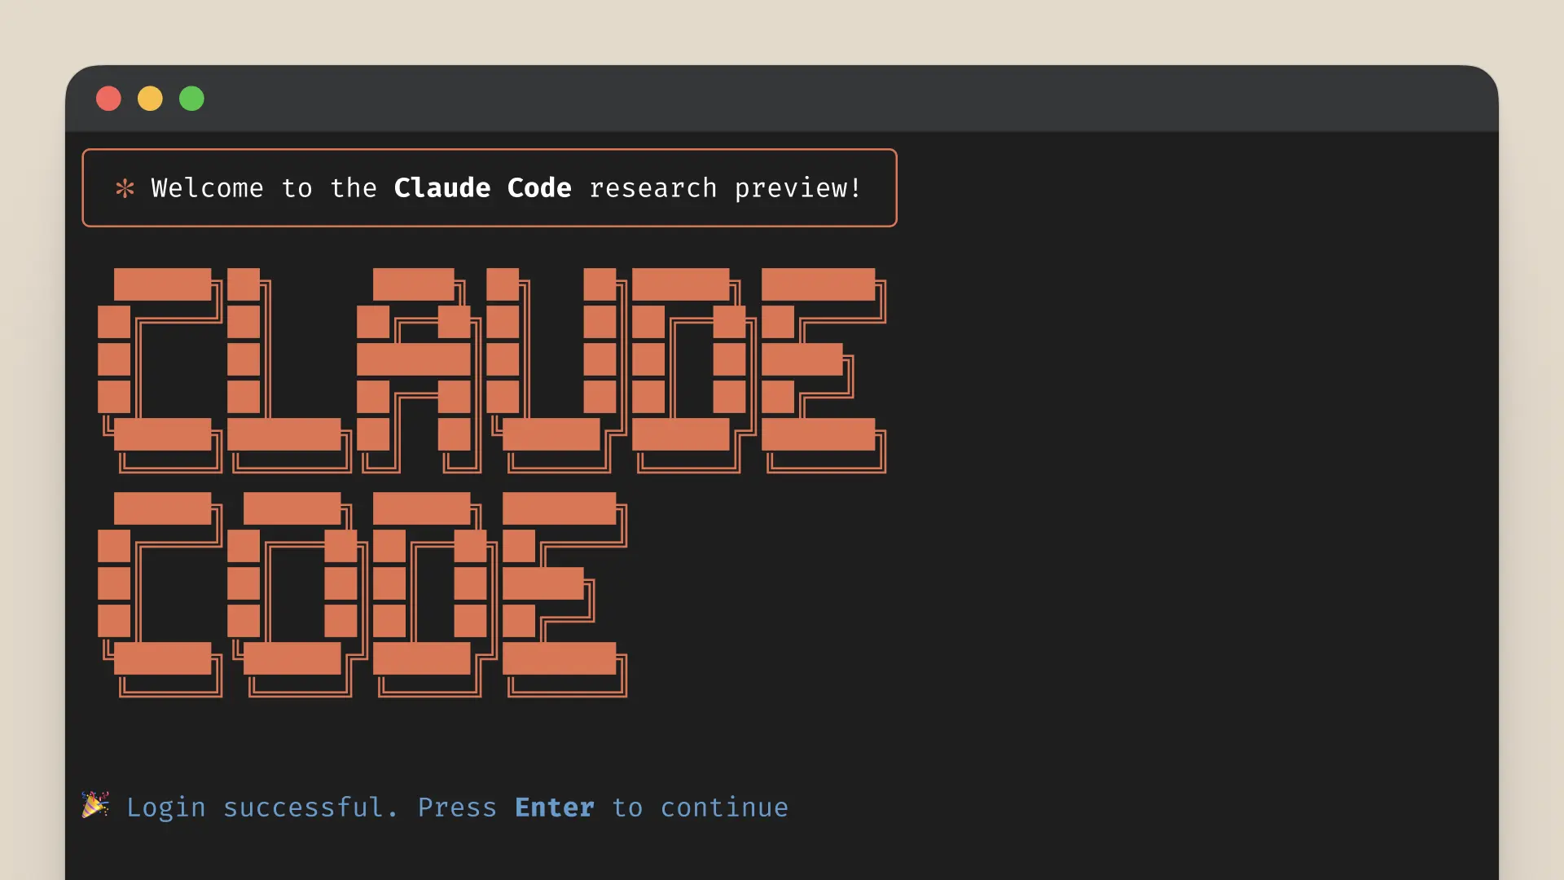
Notes:
The team agreed, so I set up Claude Code, and spent 40 MINUTES writing this first prompt.

Slide 20
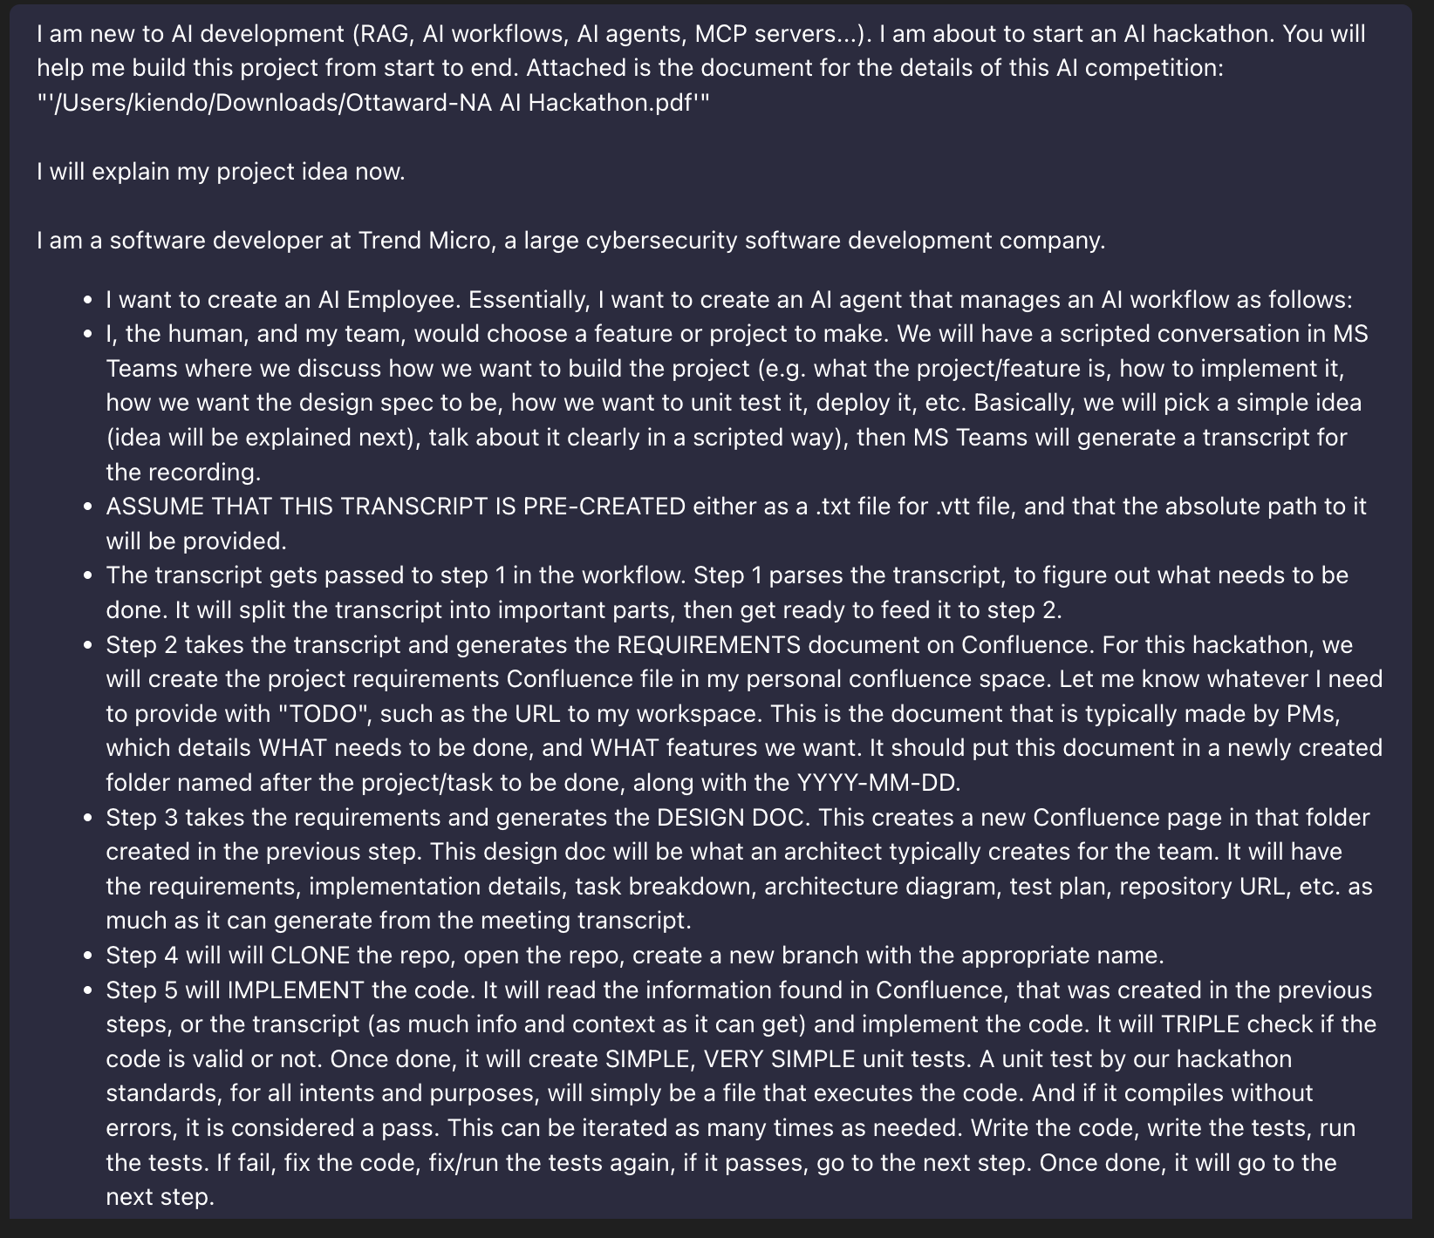
Notes:
PAUSE… That is only the FIRST part of the prompt.

Slide 21
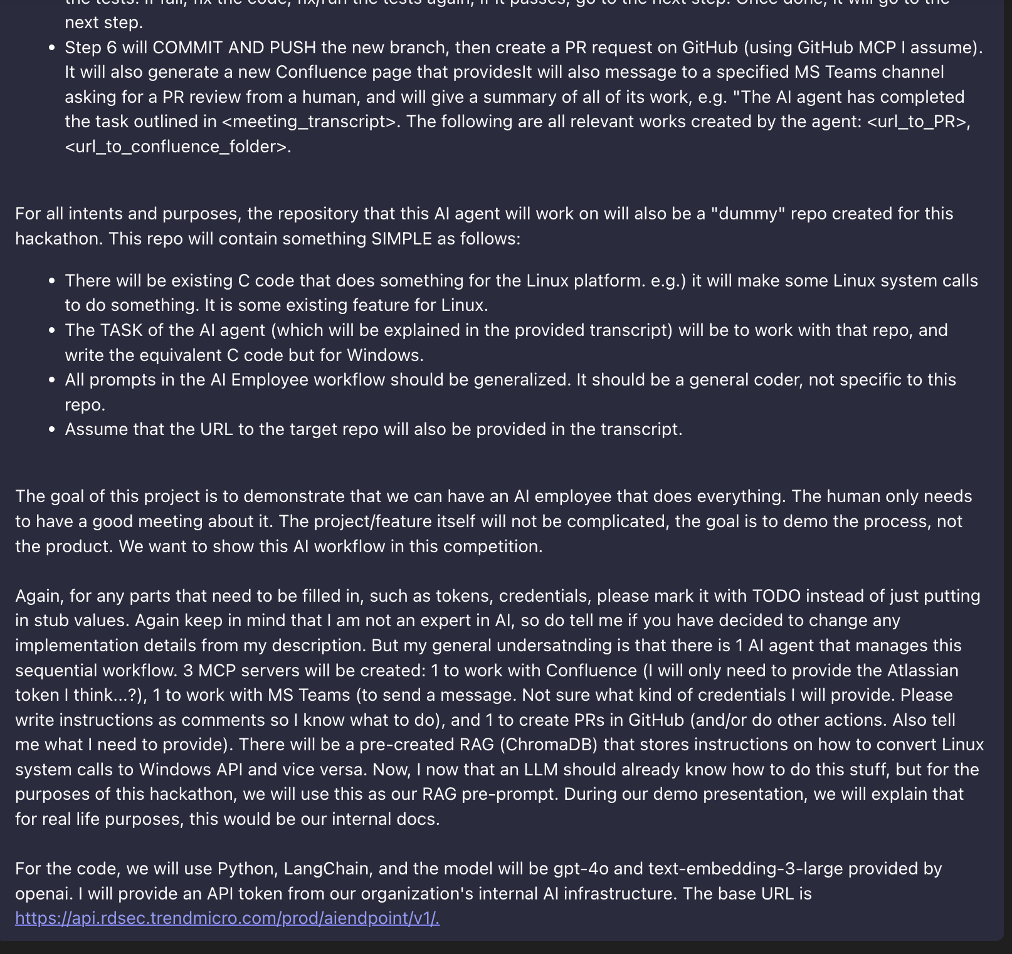
Notes:
Here is the rest. From then on, I kept working with Claude Code to finish building the project.

Slide 22
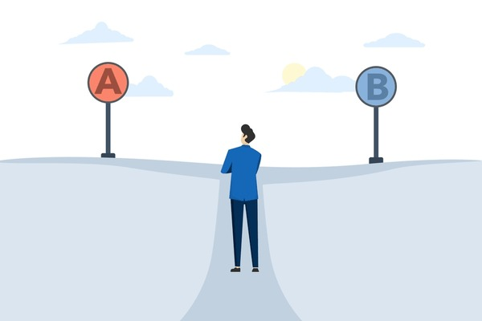
Notes:
In the end, we did not have enough time to integrate the non-vibed coded version together in time. BUT, THE VIBE CODED VERSION WORKS!

Slide 23
Demo Video
https://youtu.be/NHMcDQ9itSs
Notes:
Without further ado, we'll demo Minion AI, right now.
We start by giving this AI workflow the transcript of the PM meeting.
> CLICK START VIDEO
Then, we open the terminal and run 1 single command to start the AI workflow. That's it. You and sit back and relax.
It reads the transcript, creates the requirements, creates the technical design spec.
Clones the codebase. Creates a new branch. Implements the feature. Writes the test. Creates the PR.
Finally, it sends a Slack notification telling the developers that it has finished building this feature.
Here's the notification.
- Let's look at the PR. Very descriptive PR message to help the reviewer review the code more easily
- Let's look at the commits. Very detailed descriptions.
- One for the implementation, one for the testing, and one for documentation. Here is the code it has implemented.
...
Here are the Confluence documents that it has generated and placed neatly in 1 single folder with a detailed title and timestamp. Here is the requirements gathering, this is typically created from a TVO case... design spec, which is typically created by an architect... and feature documentation to help maintain this code in the future.

Slide 24
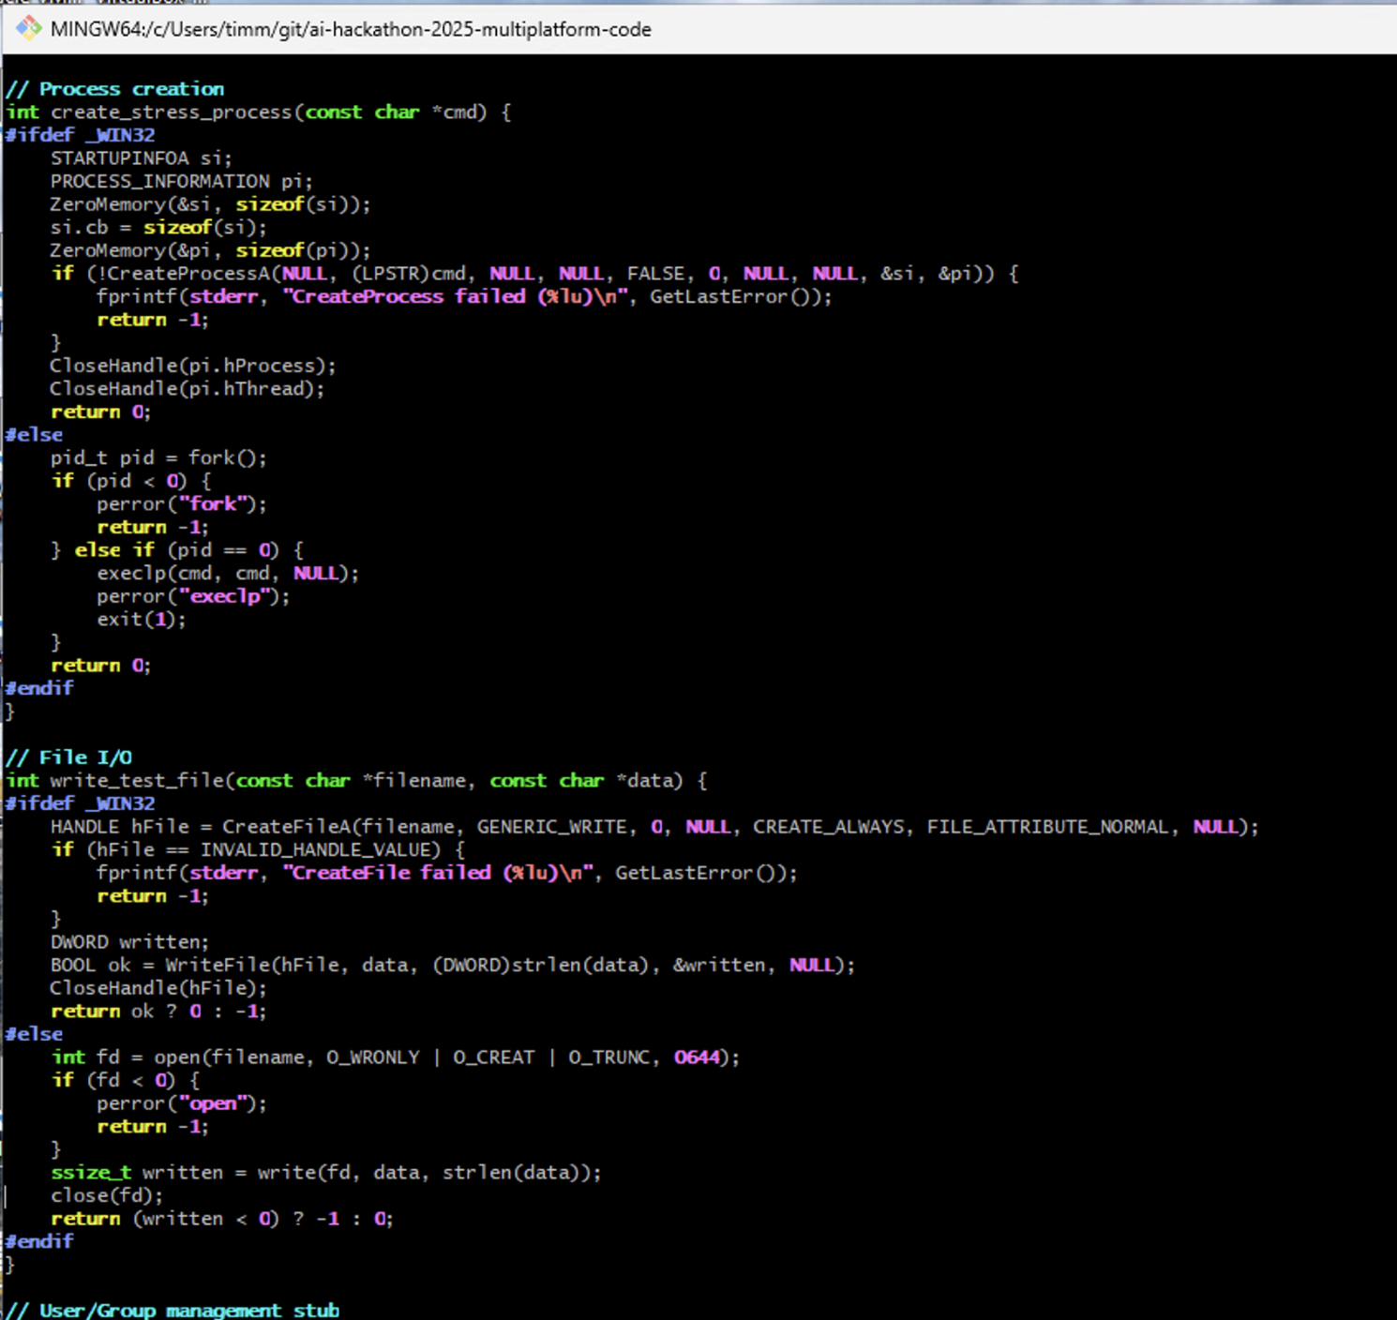
Converted Code
Only 2 of the 8 action functions were converted.
Separate #ifdef'd code blocks for both platforms
Calls correct APIs for the platforms
Results varied widely from run to run.
Notes:
Temporary notesThe code output from each run differed. For example:
The Agent only successfully converted 2 of the action functions and part of the main function.
The code that was produced uses appropriate Windows APIs and can be successfully compiled in Windows using gcc. However linking failed as the build configuration was not updated for windows which resulted in a missing symbol error.

Slide 25
Overall Challenges
Token count limits – this limits the size of the prompt
Model inconsistency
The general challenge of MCP integration was overcome by Kien asking the Agent to generate access to the tools.
Incomplete implementation of the requirements and design specification in the coding (implementation) stage.
Notes:
Temporary notes
Include future work related to other parts of the work flow, not just code implementation.

Slide 26
Future Work
Tune model to be more consistent
Add guidance to ensure development addresses build configuration (Visual Studio/makefile/Ant etc.) so that needed header files and libraries are available in the build.
Incorporate a "build" stage to generate executable/deliverable artifacts
Add guidance to ensure the Agent uses the output requirements and design documentation as an input to the implementation (coding)
Test the Agent with a more diverse set of development feature (i.e. A wide variety feature requests) to improve the tuning and guidance in the Agent.
Explore C++ to Rust Translation by incorporating learnings from Rust Training.
Make the workflow more seamless with a Lambda watching for new Meeting docs to process.
Notes:
Temporary notes
Include future work related to other parts of the work flow, not just code implementation.

Slide 27
Minion AI (Team 9)
Thank you!
Notes:
Closing slide
THANK THE JUDGES AND VIEWERS FOR THEIR TIME.

